Slide 1


Shopping Mall Management System: Admin Module Implementation
This presentation details the admin module of a shopping mall management system. It is developed using Spring Boot, JPA, and RESTful APIs for efficient data management and secure access control.
BHARATH GOWDA M R

Slide 2
Project Overview
Spring Boot
JPA
REST APIs
Provides a robust backend for managing application logic. It simplifies development with auto-configuration and embedded servers.
Handles database interactions, ensuring data persistence and integrity. It streamlines data access with ORM capabilities.
Enable seamless communication between the frontend and backend. They allow for standardized data exchange.

Slide 3




Key Technologies
Spring Boot
JPA
REST API
Streamlines backend development with its convention-over-configuration approach.
Simplifies database interactions with its ORM capabilities.
Enables efficient communication between different components of the system.

Slide 4
Package Structure
com.mall.admin
controller
model
The main application package that bootstraps the Spring Boot application.
Handles incoming API requests and routes them to the appropriate service methods.
Defines the database entities and their attributes, representing the data structure.
repository
service
Handles database operations, providing methods to interact with the database.
Implements the business logic of the application, orchestrating data flow.

Slide 5





API Endpoints
POST /admins/add
Adds a new admin to the system.
GET /admins/list
Retrieves a list of all admins.
PUT /admins/update/{id}
Updates the details of an existing admin.
DELETE /admins/delete/{id}
Removes an admin from the system.

Slide 6




Data Model: Admin Entity
Role
1
Defines admin role.
Password
2
Encrypted.
Username
3
Login name.
ID
4
Unique.

Slide 7
Service Layer Methods
getAllAdmins()
1
Fetches all admins from the database.
2
getAdminById(id)
Retrieves an admin by their unique ID.
createAdmin(admin)
3
Adds a new admin to the database.
4
updateAdmin(id, adminDetails)
Updates the information of an existing admin.
deleteAdmin(id)
5
Removes an admin from the database.

Slide 8

Conclusion
The Admin Module provides a robust and efficient solution. It leverages Spring Boot and JPA for managing admin users. Future enhancements could include advanced security and reporting.

Slide 9
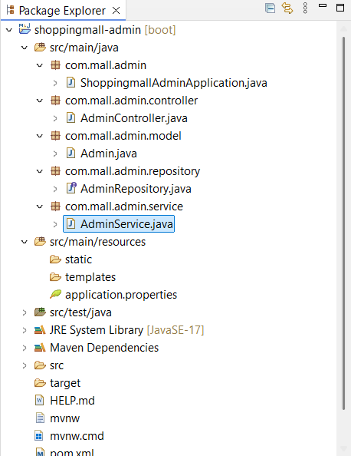
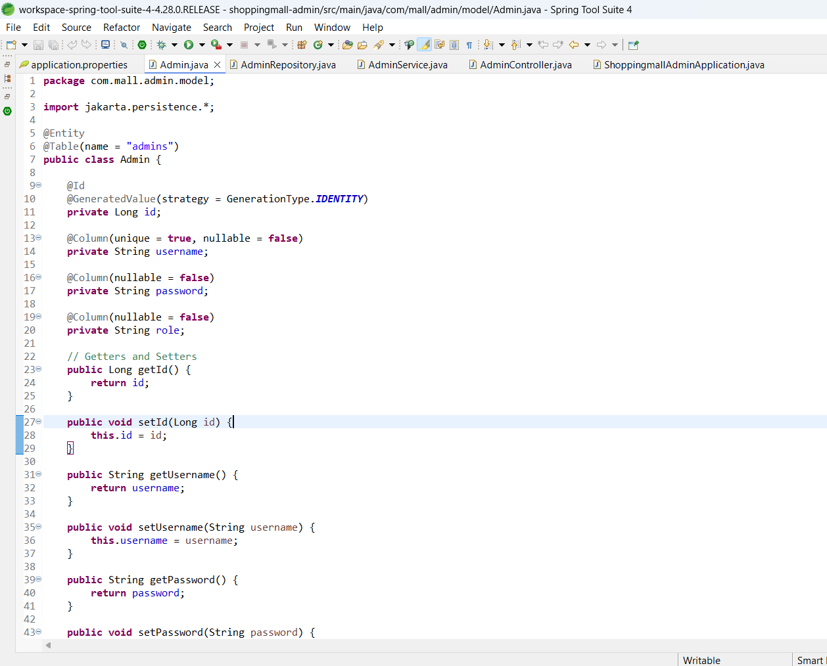
Code snippets

Slide 10
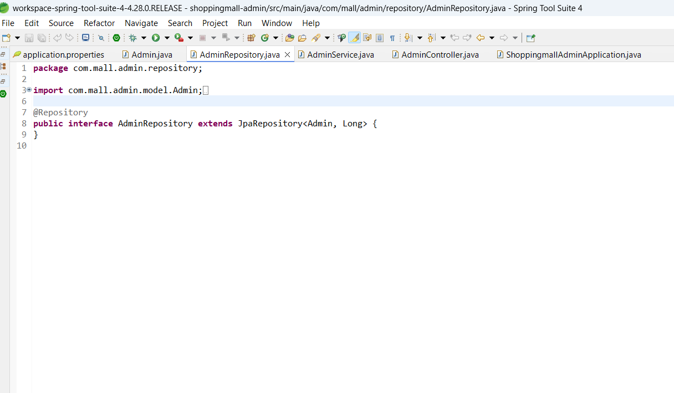
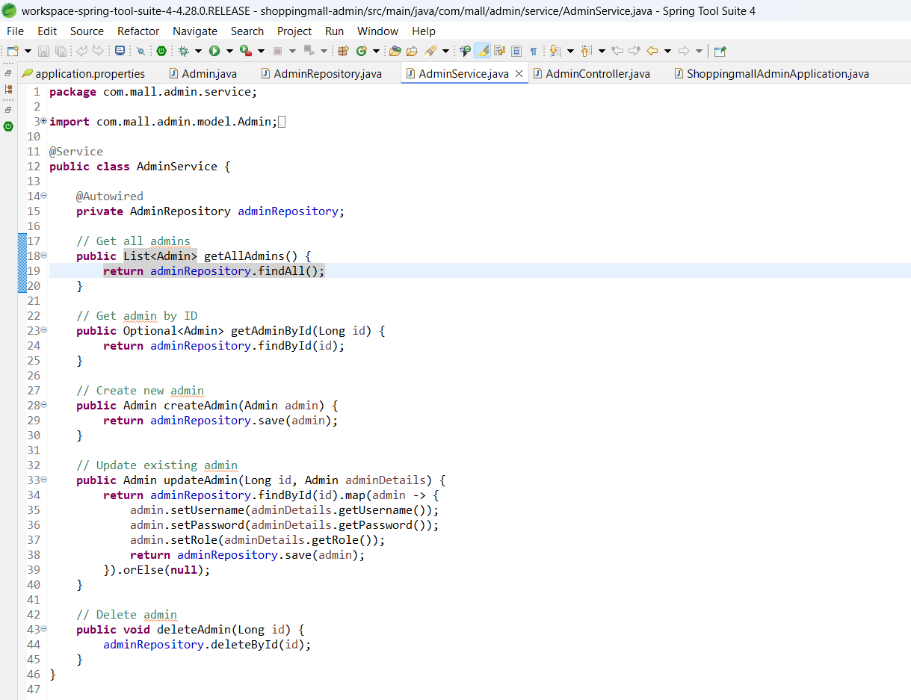

Slide 11
